Slide 1
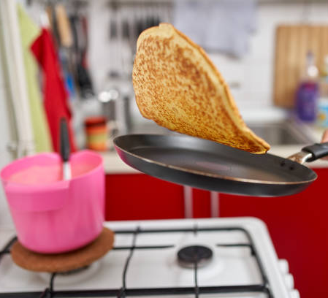
Who is the better pancake flipper?
Siva Palanisamy
July 23, 2021

Slide 2
Agenda
01
02
03
Problem Statement: Who is the better pancake flipper?
A Data-driven approach to solve this
Dive Deep into Data, Methodology & Key Findings

Slide 3

Identifying the better pancake flipper using a data-driven approach
Context
Arielle and Boris compete in the little-known sport of pancake flipping and have both been nominated for this season's "best pancake flipper" award.
Half the people in the pancake flipping league office think Arielle is the better pancake flipper, and the other half think Boris is.
Devise ways to identify the better pancake flipper among Arielle and Boris using the given dataset
A Data-driven approach to arrive at the clear winner of the pancake flipping series

Slide 4



Enriching data by adding meaningful features for analysis
Data Enrichment
Data Analysis
Derived
Data
Match
Score per attempt
Given
Data
Result
Name
Opponent Hand
Statistical testing
Independent t-testing
Understanding the winner using data-driven approach
Hand
Winner
Score
Exploratory data analysis
Score diff b/w Winner & Loser
Are Same Hands
Univariate | Bivariate analyses
Attempt
*details on next slide
Enriching given input by deriving other meaningful info for further analysis

Slide 5


Leveraging Statistical and Exploratory data analysis for identifying better pancake flipper
Statistical Method
Exploratory Method
1
2
To identify the significance of pancake flippers by comparing the two players of data using Statistical Testing
Defining hypothesis -
Null Hypothesis: Arielle and Boris are both equally competent pancake flippers
Alternate Hypothesis: Both are not equal in terms of pancake flipping performance
Using scores of Arielle and Boris, comparing the significance of these two independent players using t-test
To explore the given features and derive additional features/KPIs to make a case for identifying better pancake flipper
Types of analyses (Univariate | Bivariate analysis):
Count of Winning by Players
Sum of Scores by Winners
Num of Scores per Attempt
Variance and Standard Deviation of Players
Winning score difference by Players
Preferred Hand (Right | Left) by Winners

Slide 6
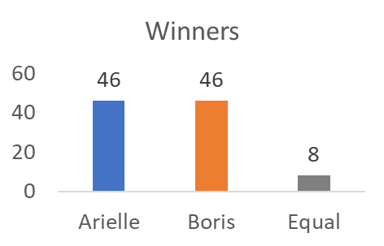
Statistical testing proved Arielle and Boris have equal pancake flipping performance and further leveraging exploratory analysis to call out a winner…
To identify the significance of pancake flippers by comparing the two players of data using Statistical Testing
Defining hypothesis -
Null Hypothesis: Arielle and Boris are both equally competent pancake flippers
Alternate Hypothesis: Both are not equal in terms of pancake flipping performance
Using two groups (scores) of Arielle and Boris, compared the statistical significance based on t-test.
As per the code file attached,
since its t-test 0.118 is lesser than critical value (1.661), we can accept the null hypothesis indicating that the two pancake flippers have performed equally well
Also taking a first-look into the data, it indicates Arielle and Boris have performed equally. However, we can possibly leverage Exploratory data analysis to deep dive for more evidences…
Note: Please refer to the code file for documentation and explanation

Slide 7
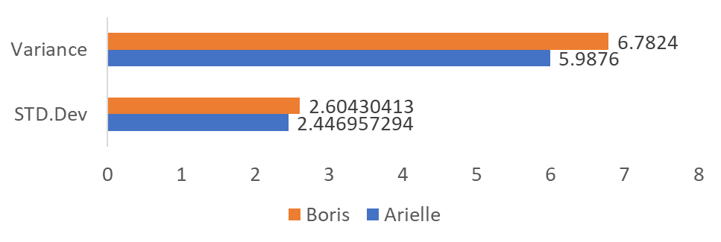
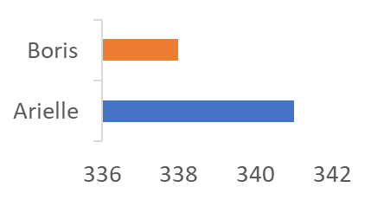
Exploratory analysis indicates that Arielle scores relatively better and consistent over Boris
To explore the given features and derive additional features/KPIs to make a case for identifying better pancake flipper using Bivariate analysis
Arielle has scored relatively higher although he has won at equal matches with Boris.
Arielle’s standard deviation is lower to Boris which gives us additional evidence that Arielle is more consistent and a reliable player to Boris.
Note: Please refer to the excel data analysis file for further explanation

Slide 8
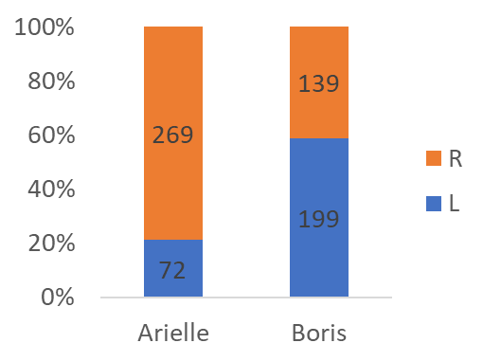
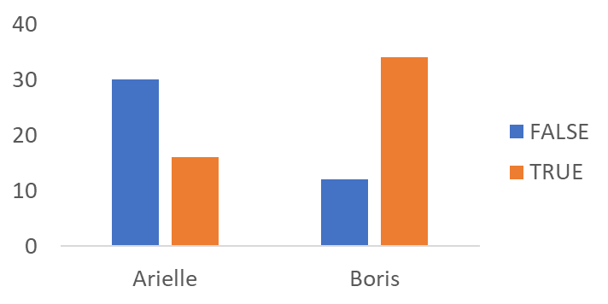
Arielle prefers Right hand often and has the edge over Boris when Arielle uses same hands as Boris uses in a match and it’s the other way around for Boris!
Arielle has used Right hand often whereas Boris used Left hand
Are same hands?
Boris has got an edge over Arielle when Boris prefers using same hand as Arielle during pancake flipping match whereas it is the other way around for Arielle to gain over Boris
Note: Please refer to the excel data analysis file for further explanation

Slide 9





Summary of analyses
In hindsight, both Arielle and Boris have won equal matches with 46 each. Statistical testing also proved the performance of both are equal
Arielle is found to be using right-hand often whereas Boris prefers left-hand
01
04
02
03
With the help of Exploratory data analysis, Arielle’s performance (scores) has relatively higher compared to Boris and standard deviation of the scores indicate Arielle is a consistent player to Boris.
Boris has got an edge over Arielle when Boris prefers using same hand as Arielle during pancake flipping match whereas it is the other way around for Arielle to gain over Boris

Slide 10
Thank You!

